Slide 1
Project
User Review NLP Analysis

Slide 2

Team Details
Team Name : Mastek_Scorpions
Leader Name : Vipul Nikam
Leader Email : rajvipul75@gmail.com
Team Members
Vipul Nikam
Prathamesh Gharge
Krutika Kotkar
Pranav Mehta

Slide 3
Project Description
Ecommerce users have to look for reviews to a product on every site to make a decision.
RPA UiPath solution will provide a GUI report of review comments for a particular product from all different web site. This report will be in the form of Graphical representation which will help user to take decision without investing his time in visiting each site and read each and every comments, this will make end user life easy.
Also this solution will help product companies to get user reviews of their product for analysis purpose which will help them to save money and will help them to utilize their resource for some other priority works.

Slide 4
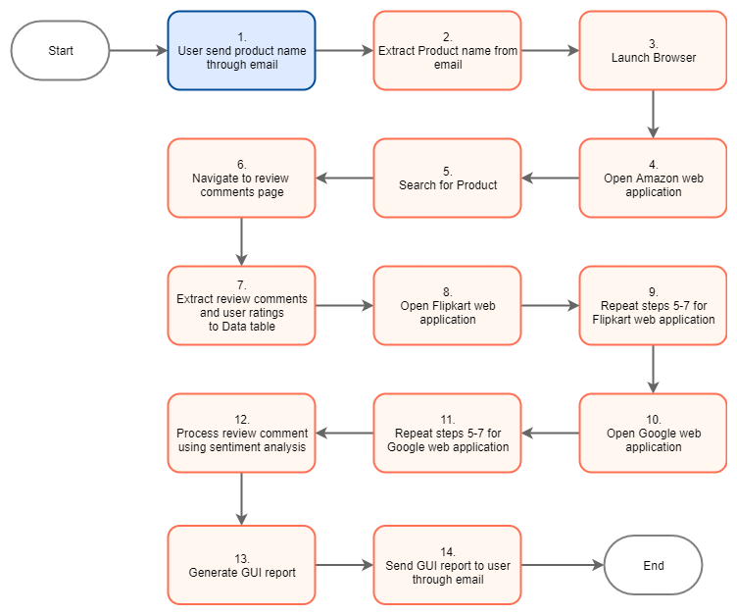
Flow Chart

Slide 5
Steps For Testing
Copy published nuggets packages from “Published nugget packages” folder to “.nuget” folder.
Copy published nuggets package from “Application nugget package” folder to “UiPath package folder” folder.
Install nuget package using UiPath Robot.
Update the config file as per requirement.
Mail a product name to configured email id.
Use following mail template
Subject :- Product review
Body :-
{Product Name}
Run the bot from UiPath Robot.
Check Analysis Report (Open the attached file using browser application)

Slide 6
Useful Links
UiPath Connect Link –
YouTube video -

Slide 7
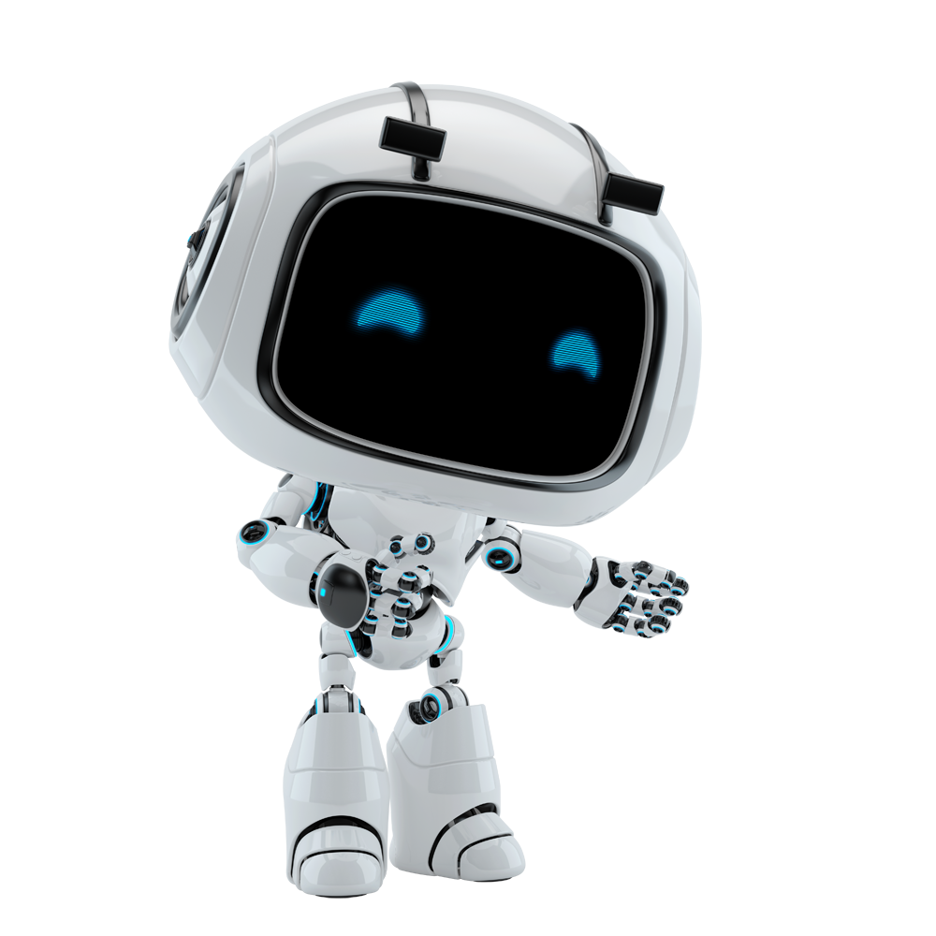
Thank You…

